Slide 1
Housing Systems of Poultry
There are four systems of housing generally found to follow among the poultry keepers. The type of housing adopted depends to a large extent on the amount of ground and the capital available.
Free-range or extensive system
Semi-intensive system
Folding unit system
Intensive system
A. Battery system
B. Deep litter system

Slide 2
Free range system: This method is oldest of all and has been used for centuries by general farmers, where there is no shortage of land.
This system allows great but not unlimited, space to the birds on land where they can find an appreciable amount of food in the form of herbage, seeds and insects, provided they are protected from predatory animals and infectious diseases including parasitic infestation. At present due to advantages of intensive methods the system is almost absolute.

Slide 3
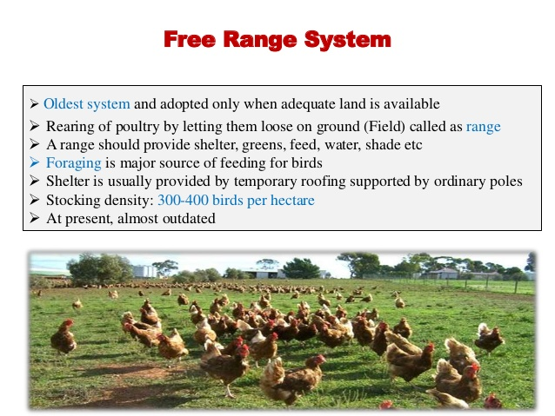

Slide 4
Semi-intensive system: This system is adopted where the amount of free spare available is limited, but it is necessary to allow the birds 20-30 square yards per bird of outside run. Wherever possible, this space should be divided giving a run on either side of the house of 10-15 square yards per bird, thus enabling the birds to move onto fresh ground.

Slide 5
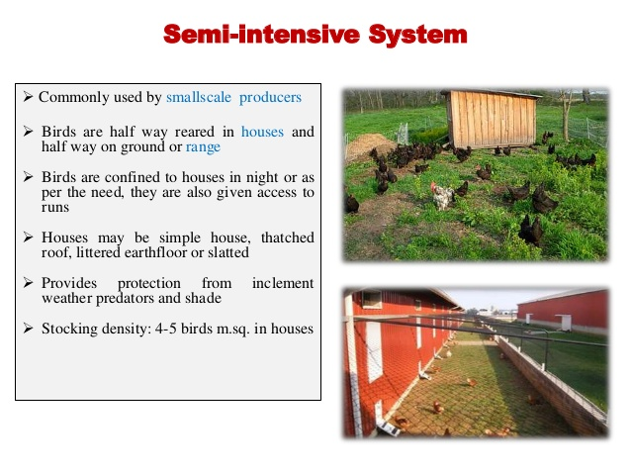

Slide 6
Folding unit System: This system of housing is an innovation of recent years. In portable folding unit’s birds being confined to one small run, the position is changed each day, giving them fresh ground and the birds find a considerable proportion of food from the herbage are healthier and harder

Slide 7
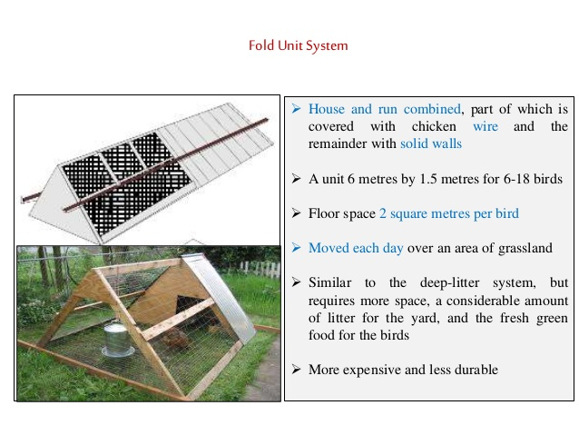

Slide 8
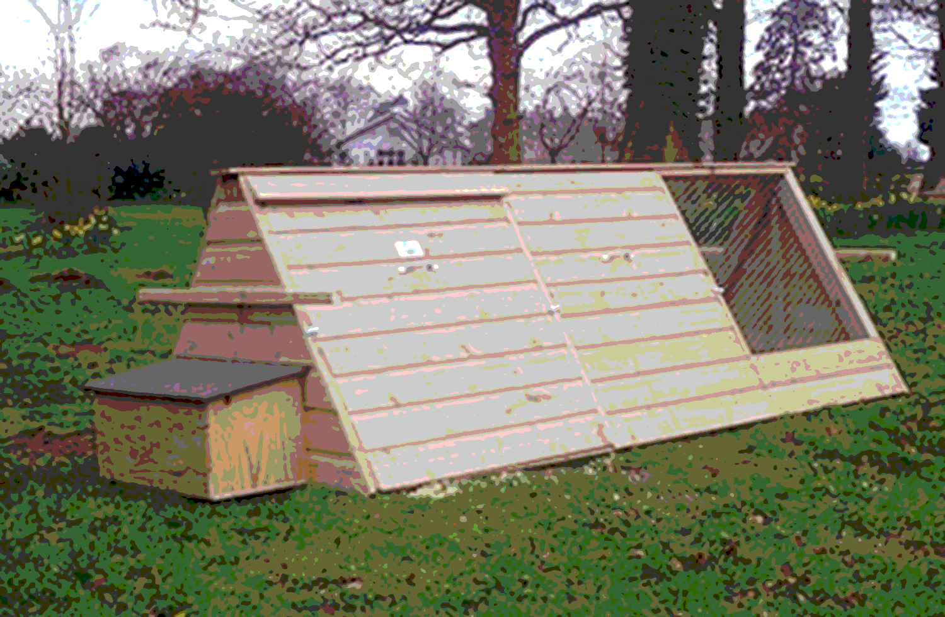
Folding Unit ystem
Notes:
Folding Unit ystem

Slide 9
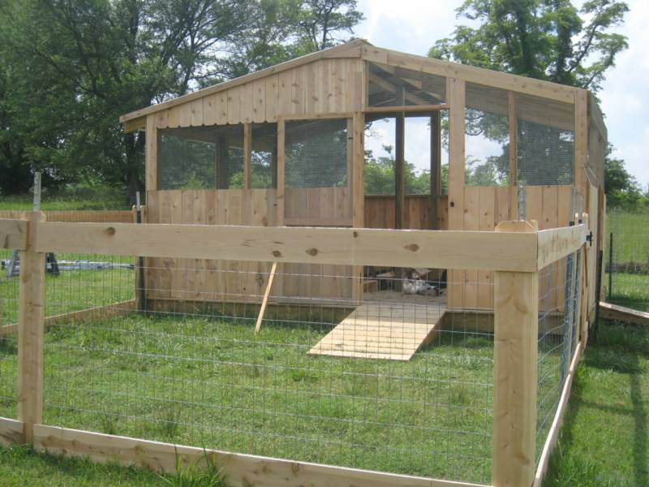
Folding Unit ystem

Slide 10
For the farmer the beneficial effect of scratching and manuring on the land is another side effect. The disadvantages are that food and water must be carded out to the birds and eggs brought back and there is some extra labor involved in the regular moving of the fold units. The most convenient folding unit to handle is that which is made for 25 hens. A Floor space of 1 square fool should be allowed for each bird in the house, and 3 square feet in the run, so that a total floor space to whole unit is 4 square feet per bird, as with the intensive system. A suitable measurement for a folding house to take 25 birds is 5 feet wide and 20 feet long, the house being 5' X 5', one third of Ibis fun. The part nearest the house is covered in and the remaining 10' open with wire netting sides and lop.

Slide 11
Intensivesystem:
In this system the birds are confined to the house entirely, with no access to land outside, and it is usually adopted where land is limited and expensive.
This has only been made possible by admitting the direct rays of the sun on the floor of the house so that par to the windows are removable, or either fold or slide down like windows of railway train to permit the ultraviolet rays to reach the birds. Under the intensive system, Battery (cage system) and deep litter methods are most common.

Slide 12
A. Battery system: (cage system) This appliance is the inventor's latest contribution to the commercial egg farmer. This is the most intensive type of poultry production and is useful to those with only a small quantity of floor space at their disposal. Nowadays in large cities hardly a poultry lover can spare open lands for rearing birds. For all such people this system will prove worthy of keeping birds al minimum space.
In the battery system each hen is confined to a cage just large enough to permit very limited movement and allow her to stand and sit comfortably. The usual floor space is 14 X 16 inches and the height, 17 inches. The floor is of standard strong galvanized wire set at a slope from back to the front, so that the eggs as they are laid roll out of the cage to a receiving gutter.

Slide 13
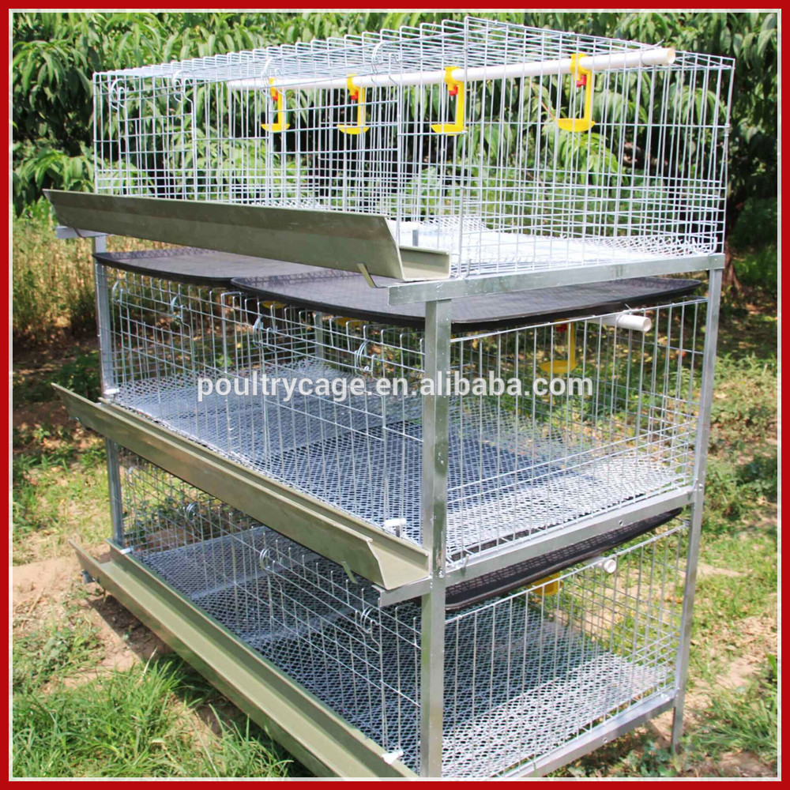

Slide 14
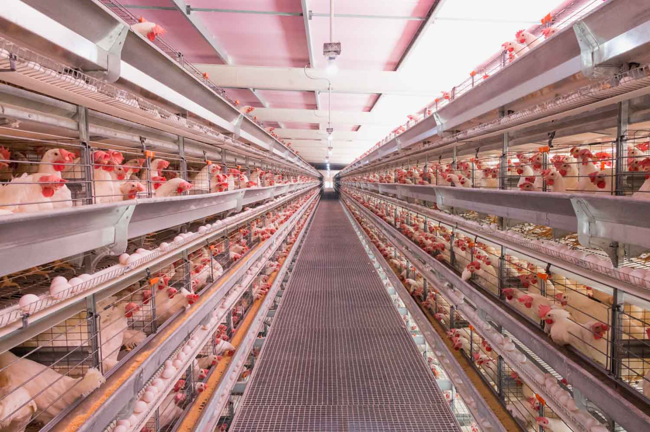

Slide 15
Underneath is a tray for droppings. Both food and water receptacles are outside the cage. Many small cages can be assembled together; if necessary It may be multistoried. The whole structure should be of metal so that no parasites will be harbored and through disinfection can be carried out as often as required. Provided the batteries of cages are set up in the place which is well ventilated and lighted, is not too hot and is vermin proof and that the food meets all nutritional needs, this system has proved to be remarkably successful in [lie tropical countries. It may be that as it requires a minimum expenditure of energy from the bird, which spends its entire item in the shade, it lessens the load of excess body heat. The performance of each bird can be noted and culling easily carried out. Pullets, which are more often used than birds of over one year, should be placed in the cages at least one month before they are expected to lay.

Slide 16
The feeding of birds in cages has to be carefully considered, as the birds are entirely dependent on the mash for maintenance and production. To supply vitamins A and D, cod liver oil, yeast, dried milk powder are useful/ and fish meal or other animal protein, and balanced minerals and some form of grit must be made available.
As in each cage there will be only pullets so one can never expect fertilized eggs, hence the vegetative eggs will be there, which can be preserved for a longer time than fertilized eggs at ordinary room temperature but can never be used for hatching purposes.

Slide 17
B. Deep litter system: In this system the poultry birds are kept in large pens up to 250 birds each, on floor covered with litters like straw, saw dust or leaves up to depth of 8-12 inches. Deep litter resembles to dry compost. In other words we can define deep litter, as the accumulation of the material used for litter with poultry manure until it reaches a depth of 8 to 12 inches. The build-up has to be carried out correctly to give desired results, which takes very little attention.

Slide 18
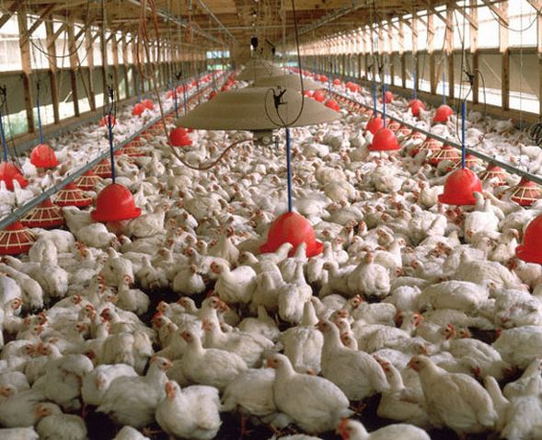

Slide 19
Advantages of Deep Litter System:
Safety of Birds: Birds on rage of even in a netted yard can be taken by wild animals, flying birds, etc. When enclosed in deep litter intensive pen which has strong wire netting or expanded metal, the birds and eggs are safe.
Litter as a source of food supply: It may come as surprise to learn that built-up deep litter also supplies some of the food requirements of the birds. They obtain "Animal Protein Factor" from deep litter and some work

Slide 20
indicates that this could learn that birds obtain sufficient of this to enable to suitable feed ration to be prepared with only a vegetable protein such as groundnut meal included in the feed. The level of vitamins such as riboflavin increases up to nearly three-fold. According to experiments conducted. The combination of this and the Animal Protein Factor is necessary to good hatchability of eggs and early growth of chickens.

Slide 21
Disease control: Well managed deep litter kept in dry condition with no wet spots around water has a sterilizing action. The level of coccidiosis and worm infestation is much lower watered kept on good deep litter than with birds (or chickens) in bare yards and bare floor sheds particularly where water spillage is allowed.
Labour saving: This is one of the really big features of deep litter usage. Cleaning out poultry pens daily or weekly means quite a lot of work. With correct conditions observed with well managed litter there is no need to clean a pen out for a whole year; the only attention is the regular stirring and adding of some material is needed.

Slide 22
The valuable fertilizer: This is a valuable economic factor with deep litter. According to McArdle and Panda, 35 laying birds can produce in one year about 1 tonne of deep litter fertilizer. The level of nitrogen in fresh manure is about 1%, but on well built-up deep litter it may be around 3 per cent nitrogen (nearly 20% protein). It also contains about. 2 per cent phosphorus and 2 per cent potash, its value is about 3 times that of cattle manure. Hot weather safeguard: This is an important feature in a hot climate. The litter maintains its own constant temperature, so birds burrow into it when the air temperature is high and thereby cool themselves. Conversely, they can warm themselves in the same way when the weather is very cool. Accordingly, it is a valuable insulating agent.

